Slide 1
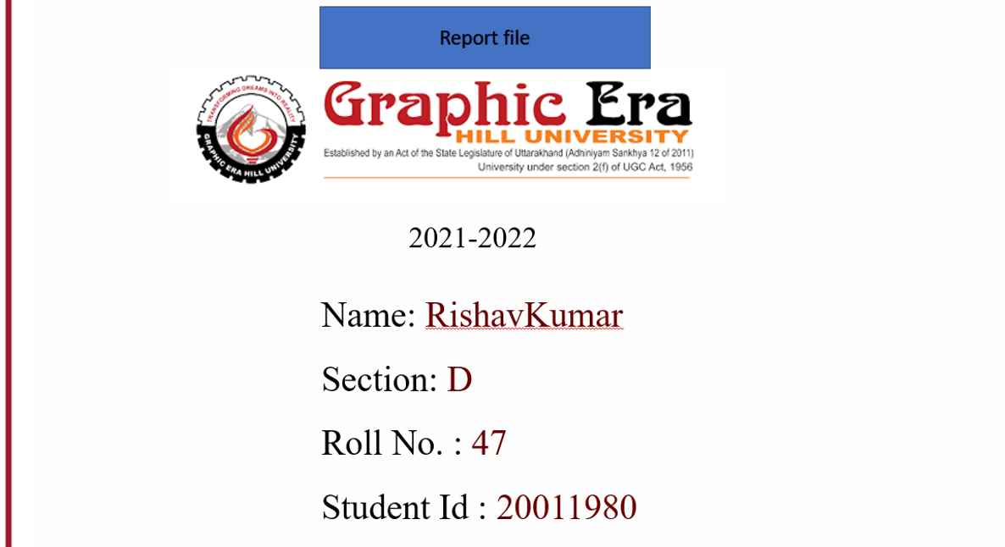

Slide 2
Mini Project Topic
Random password generator

Slide 3
PROJECT
Written In Python language
Works In GUI
Password Length From 6 To 32
Provides Choices To Customize The Password
Password Can Contain Lower Case, Upper Case, Digits And Special Characters
Creates A Text File Containing Saved Passwords

Slide 4
WORKING OF THE PROJECT - 1
Imports All The Modules/Library Used
String Module
Random Module
Tkinter Library
Time Module
OS Module
Base64 Module
PyperClip Module

Slide 5
WORKING OF THE PROJECT - 2
From String Module, Storing All The Necessary String Characters Into Different Variables.
Using Tkinter Library, Creating 5 Check Boxes For The Customization
Check Boxes Will Be ‘Lower’, ‘Upper’, ‘Digits’, ‘Symbols’ And ‘Default’
Defining Functions To Adding Desired Characters Into Password Generating

Slide 6
WORKING OF THE PROJECT - 3
The Functions Will Check Whether The Check Box Is Ticked Or Not Using If-Else Statement
If The Condition Is True Then The Chosen Characters Will Be Added A Variable named ‘Temppass’
Else The Same Characters Will Be Removed From The Variable ‘Temppass’
The Check Boxes Will Have The Defined Functions As Commands

Slide 7
WORKING OF THE PROJECT - 4
Using Tkinter Library, Creating A Combo Box With Values From 6 to 32
The Length Of The Password Is Input Through The Combo Box
Define A Function To Generate The Password.
Using Random Module With The ‘Temppass’ Variable And The Length, The Password Is Generated And Stored In Variable Named ‘Password’
Using Tkinter Library, Creating A Button “Generate”
The Button Will Have Generate Function As Command

Slide 8
WORKING OF THE PROJECT - 5
Using Tkinter Library, Creating An Entry
The ‘Password’ Variable Is Passed Into The Entry And Displayed To The User
Using OS Module, Create A File In A Specific Directory
Directory - “C:\R.P.G\Pass.txt”
Defining Function To Check Whether The Pass.txt Is Empty Or Not.
If The File Is Empty Then Open The File And Write Specific String Into The File

Slide 9
WORKING OF THE PROJECT - 6
Using Time Module, Get The Local Time And Store It Into A Variable Named ‘current_time’
Format = “From DD/MM/YY At H/M/S P”
Define A Function To Copy And Save The Password Generated
Using The Pyperclip Module, The Password Is Copied
To Save The Password, The Password Is Appended Into The Text File “Pass.txt” Along ‘current_time’ And Serial Number
Using Tkinter Library, Creating A Button “Copy/Save”
The Button Will Have Copy And Save Function As Command

Slide 10
WORKING OF THE PROJECT - 7
Define A Function To View Password
If The Password File Is Empty Then Using Tkinter Library Show A Warning Message Box
Else Using OS Module Open The File In Notepad.exe
Using Tkinter Library, Create A Button “View”
The Button Will Have View Function As Command

Slide 11
WORKING OF THE PROJECT - 8
Define A Function To Reset Password File
Open The File And Strip All The Lines From The File
Using Tkinter Library, Create A Button “Reset”
The Button Will Have Reset Function As Command
Using Tkinter Library, Create 3 Labels To Display Text
Text 1 – “Generated Password”
Text 2 – “Password’s Length”
Text 3 – “Random Password Generator”

Slide 12
WORKING OF THE PROJECT - 9
Icon Image File is Embedded Into The Project
The Image Is Converted Into Base64 String And In The Project Decoded Into Image File And Used As Icon
All The Buttons, Labels And Entry Is Then Placed In There Respective Places In The GUI Window
The Project File .py Is Converted Into .exe File Using PyInstaller
Command - pyinstaller --onefile -w R.P.G.py

Slide 13
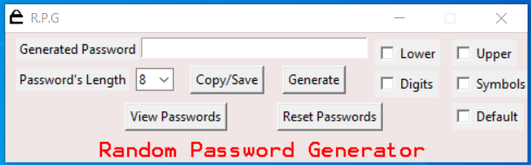
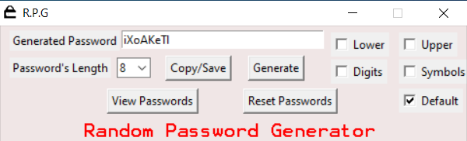
SNAP-SHOTS OF PROJECT - 1

Slide 14
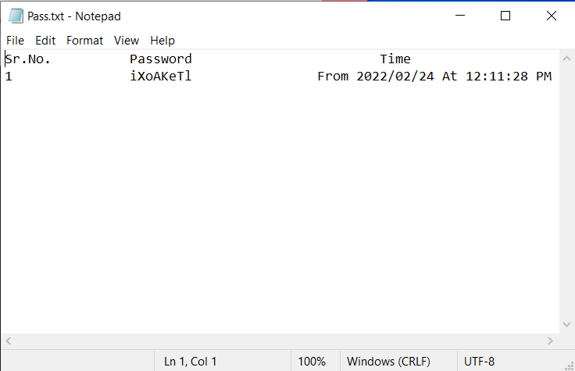
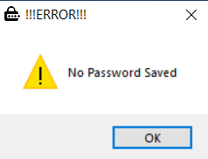
SNAP-SHOTS OF PROJECT - 2

Slide 15
Thank you

